Slide 1
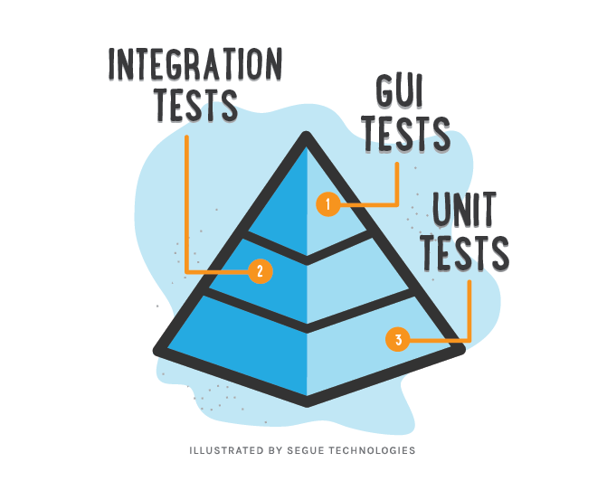
Unit Testing
10 th May 2020

Slide 2
What is Unit Testing ?
Unit testing is a level of software testing where individual units/components of a software are tested. In the React world this means testing an individual React Component or pure functions.
1. Test
It help determine if the isolated modules of software work correctly
2. Bugs preventing
Unit testing helps developers make refactoring and regression easier
3. Documentation
Unit tests can be used as the documentation for code, which is extremely important for big projects.
4. Clarification of specs
let you foresee in advance the testability of the functionality, find some gaps in the specification,

Slide 3

List of Testing FrameWork
we had explored some testing frameworks along with our react application.
Jest
Mocha
React-testing-library

Slide 4
Assertion library
Assertions library is what actually runs the specs and determines whether any given condition is valid or not.
A True result indicates that a test passed, indicating that the expected behavior is what occurred when the test ran.
Jest and react-testing has it's own assertion library built-in which helps the user to test the behavior
2. 3rd Party Assertion library
Mocha can be combined with Chai libraries for assertion.
Chai is an assertion library that plugs into Mocha.

Slide 5
Snapshots
A snapshot test generates an HTML-like output so you can see how your component is structured
Strategies
It works well with React components because when you render a component you can view the DOM output and create a “snapshot” at the time of run.
expect(“content”).toMatchSnapshot();
If your component does not update often, is not complex, and is easy to see exactly what you are testing, then a snapshot test might work.
Functioning
Behavior
Jest and react-testing has it's own snapshot built-in which helps the user to take snapshots.
We use 3rd Party package to take snapshot in mocha. "chai-jest-snapshot"
Jest / React Testing Library
Mocha

Slide 6
Mock API Call
Mock functions allow you to test the links between code by erasing the actual implementation of a function, capturing calls to the function.
Ways to mock functions
creating a mock function to use in test code.
Intercepts the HTTP Requests
writing a manual mock to override a module dependency.
Functioning
Behavior
Jest and react-testing has it's own mock built-in which helps the user to capture function calls.
“jest.mock(‘… ');”
We use 3rd Party package to take snapshot in mocha.
“npm install nock http"
Jest
Mocha

Slide 7

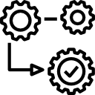

Enzyme
Methods
Test
Independent
Operation
60 plus pre-defined methods
Shallow rendering
Static Rendering
Full Rendering
unopinionated regarding which test runner or assertion library you use
chai-enzyme with Mocha/Chai.
jest-enzyme with Jest.
Future
Enzyme is a JavaScript Testing utility for React that makes it easier to test your React Components
Improved event simulation and propagation support
Improved Keyboard + Mouse Simulation

Slide 8

Code Coverage
Straightforward process, add tests and see if coverage improves
simple measurement of the percentage of our source code that was executed during a cycle of automated tests
Istanbul
Easy to setup and measure coverage
Benefits
Helps to capture bugs in program flow

Slide 9



Testing with React Testing Lib / Jest
Test Output
Install
npm install --save-dev jest
Containsases
Configure the script in package .json to run test
"test": "react-scripts test /jest test "
Error
Test passed
console
Write test cases based on our components
Failed cases
Success Message
To Start the test
npm run test

Slide 10
Testing with Mocha
Installation
Configuration
To run
Operations
Test
Ends
Start the test
Write test cases based on our components
Install the Dependencies
npm run test
Test result will be showed in the console
Configure the package.json
Process
Mocha
Chai
Enzyme
Babel (core, cli, register, preset env)
chai-jest-snapshot
"test": “mocha test --require @babel/register --require ignore-styles”
Start
Mocha accepts only ES5. so we need to configure babel which converts ES6/7/8 to ES 5 .

Slide 11
Thank You

